Slide 1
Automatic Target Scoring
Mid Project Presentation
-- Ninad P.Chaudhari

Slide 2
Steps
Detect the small circle.
Refine the Circle as much as I can.
Detect the large Circle.
Get centers
Study the standards for the target
Formula to calculate the score after giving centers.
Make it independent of scale.
Study Techniques for mobile CV Compute.
Transfer logic to Mobile device.

Slide 3
Make The smaller circle better
Like in various papers, I am assuming best case
even assuming that I have detected the circle.
Trying closing and opening operations.

Slide 4
Mobile Development
Demo – Canny
Ways to do CV on Mobile – 2
1 - Java OpenCV
2 – Write OpenCV on Computer, compile for every platform and build wrapper.
Hough circle lags. Somehow need to specify Framerate or skip a few frames.
Resize should do the trick – But I loose accuracy.

Slide 5
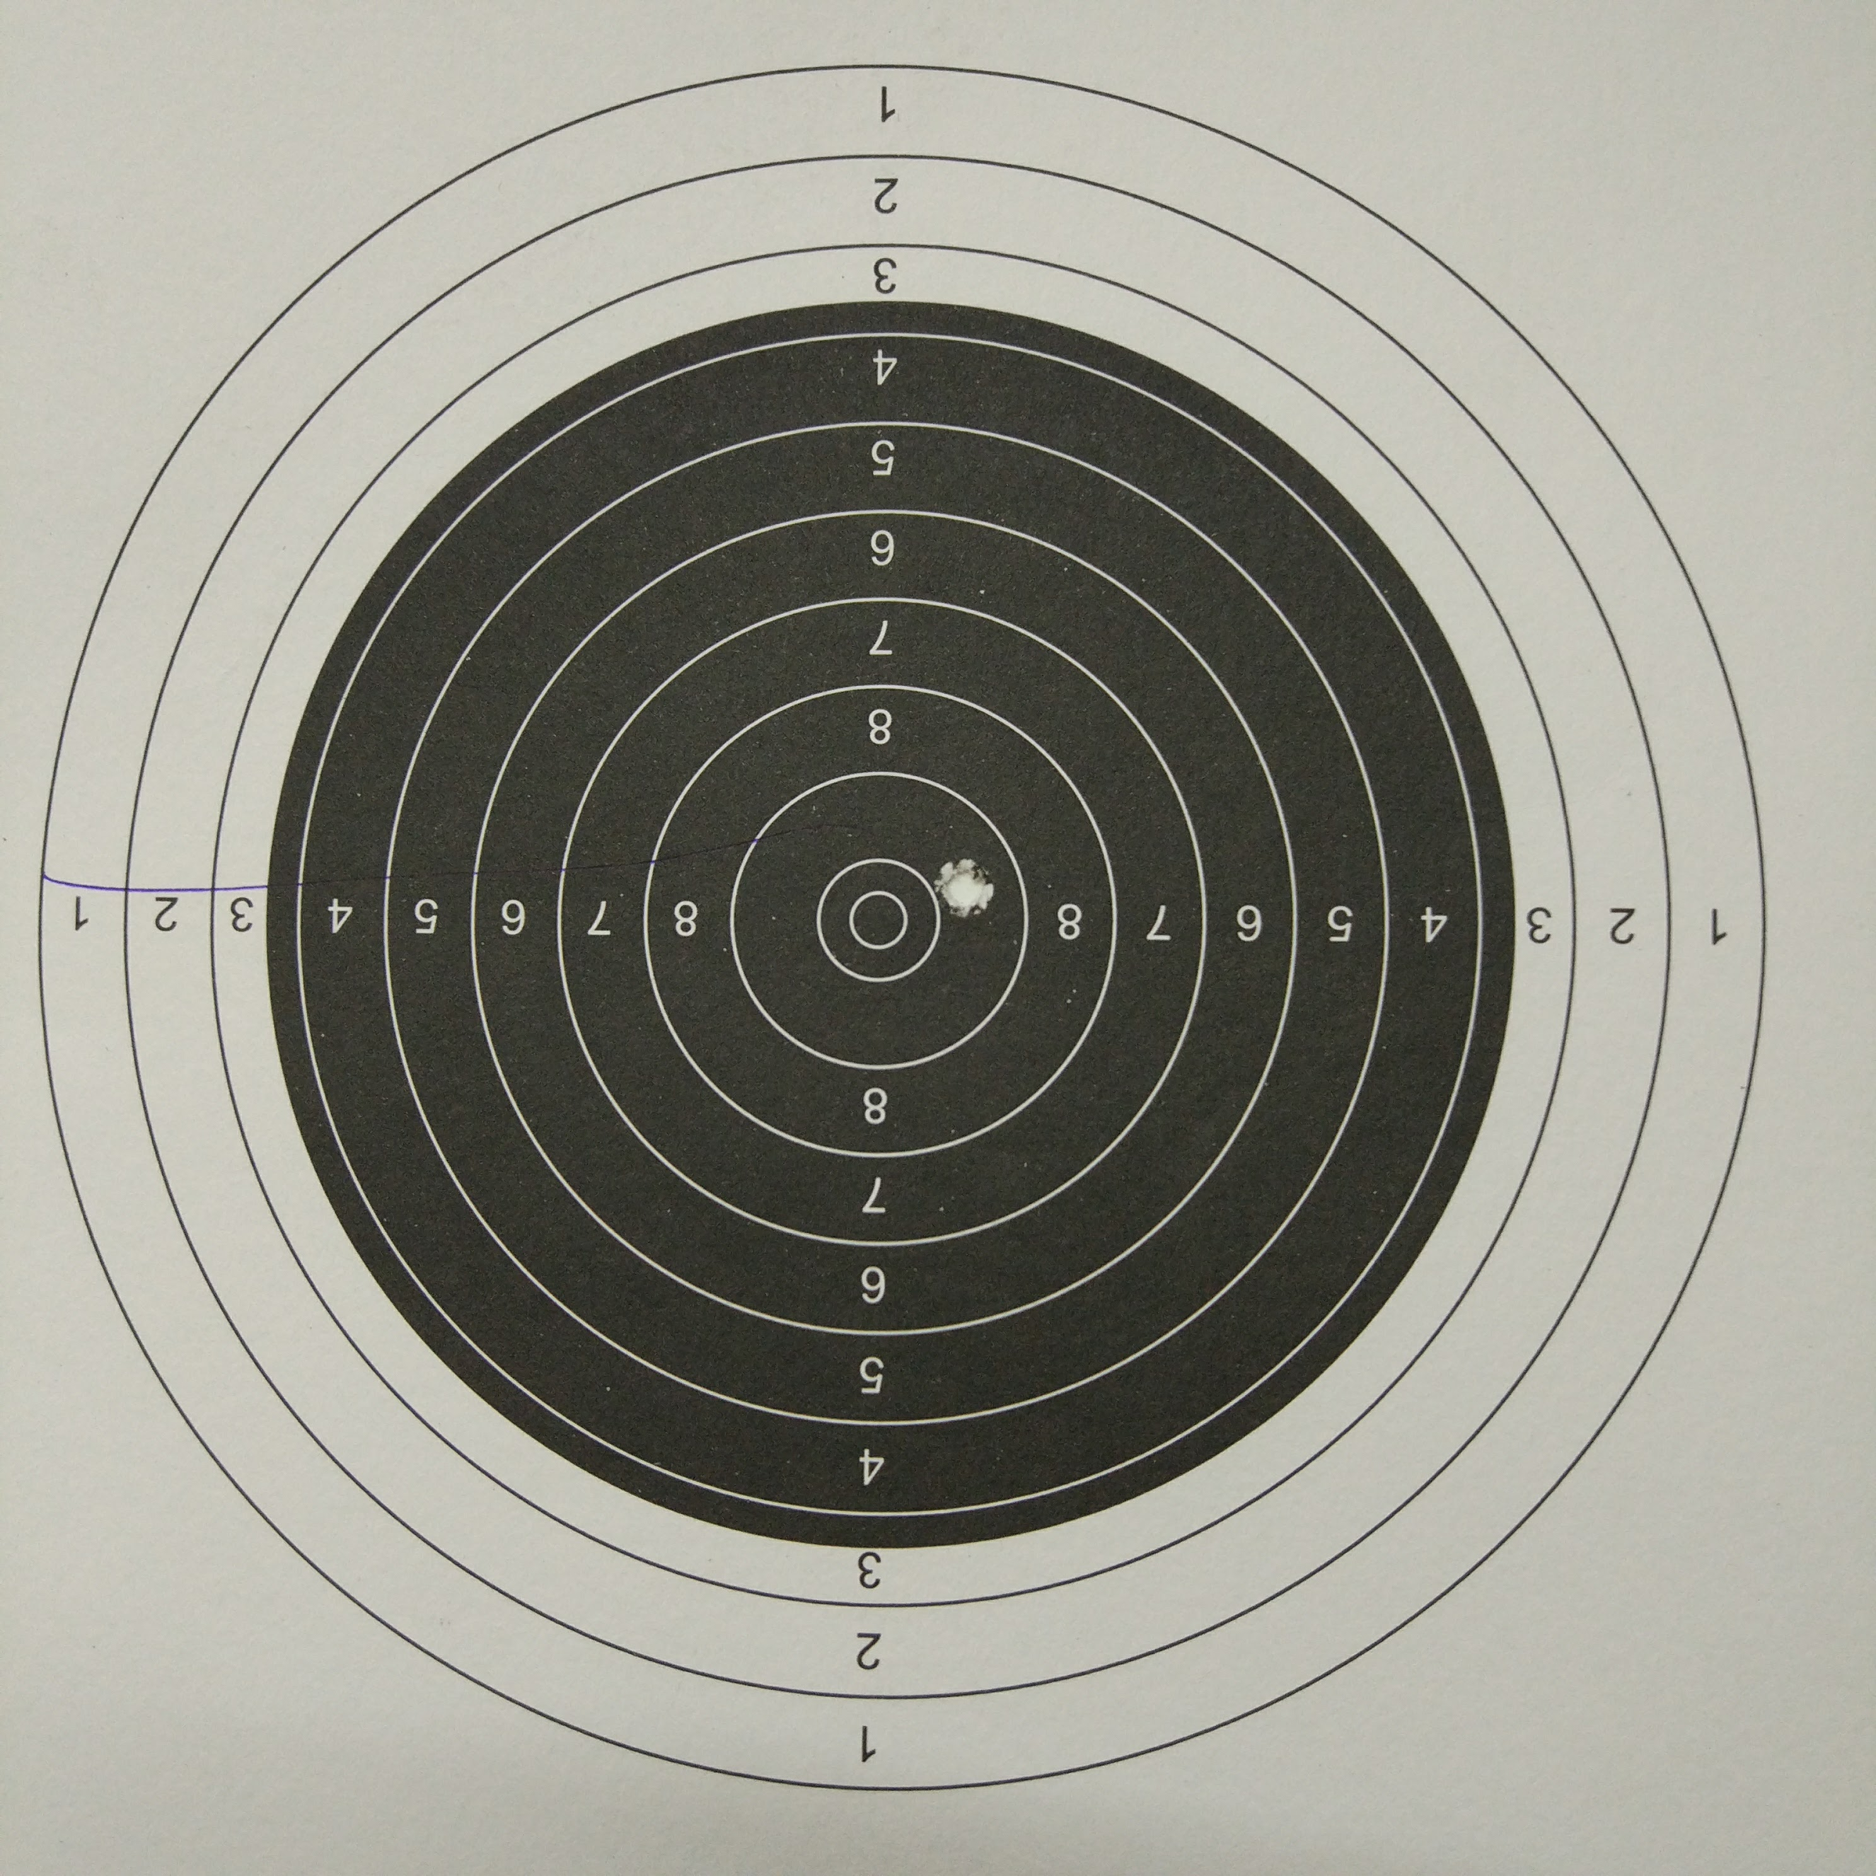
Target Information
0.5mm Think Line.
If it touches line, It’s the inner point.

Slide 6
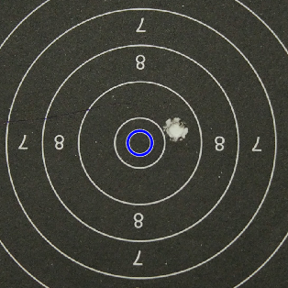
Hough for each ring – Doesn’t work very well

Slide 7
Demo!
Thank You.

